Slide 1
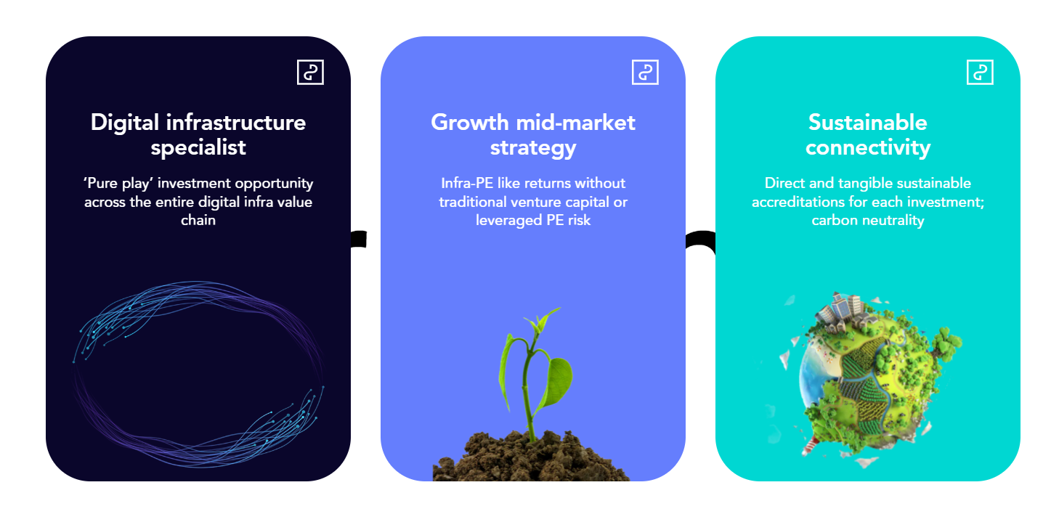
Specialised focus
143 yrs
Digital infrastructure experience
Partnerships and networks
6
strategic relationships with telcos, MNOs and global tech
Authentic sustainability
Article 8
Mandate across our Fund’s DGP advises on

Slide 2
Proven track record
2.8x
realised gross MOIC
Operational focus
15
upper-level management and NED roles placed across the portfolio
Thought leadership
>100 hrs
of digital infra speaking slots attended

